Slide 1
Autonomous Vocal and Backing Track Mixing
Master Project Proposal
Kelian (Mike) Li
Music Informatics Group

Slide 2
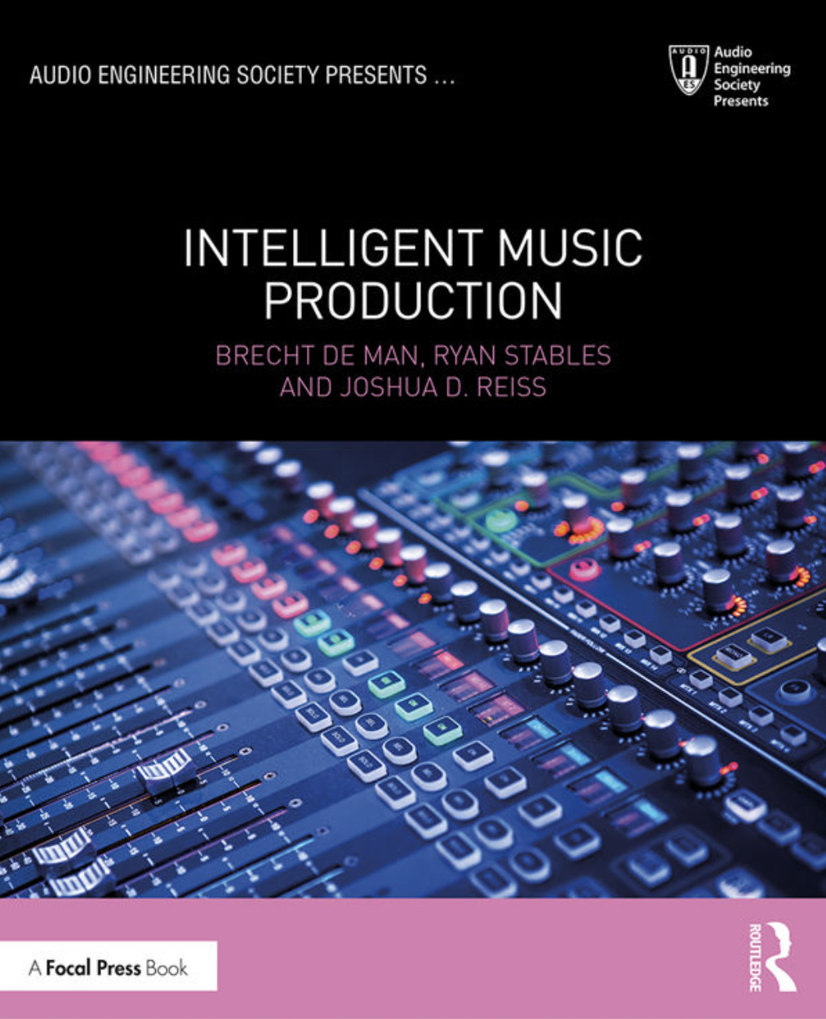
Motivation
Over 10 years of research on Multitrack mixing
No significant achievements yet
How about an easier task?

Slide 3
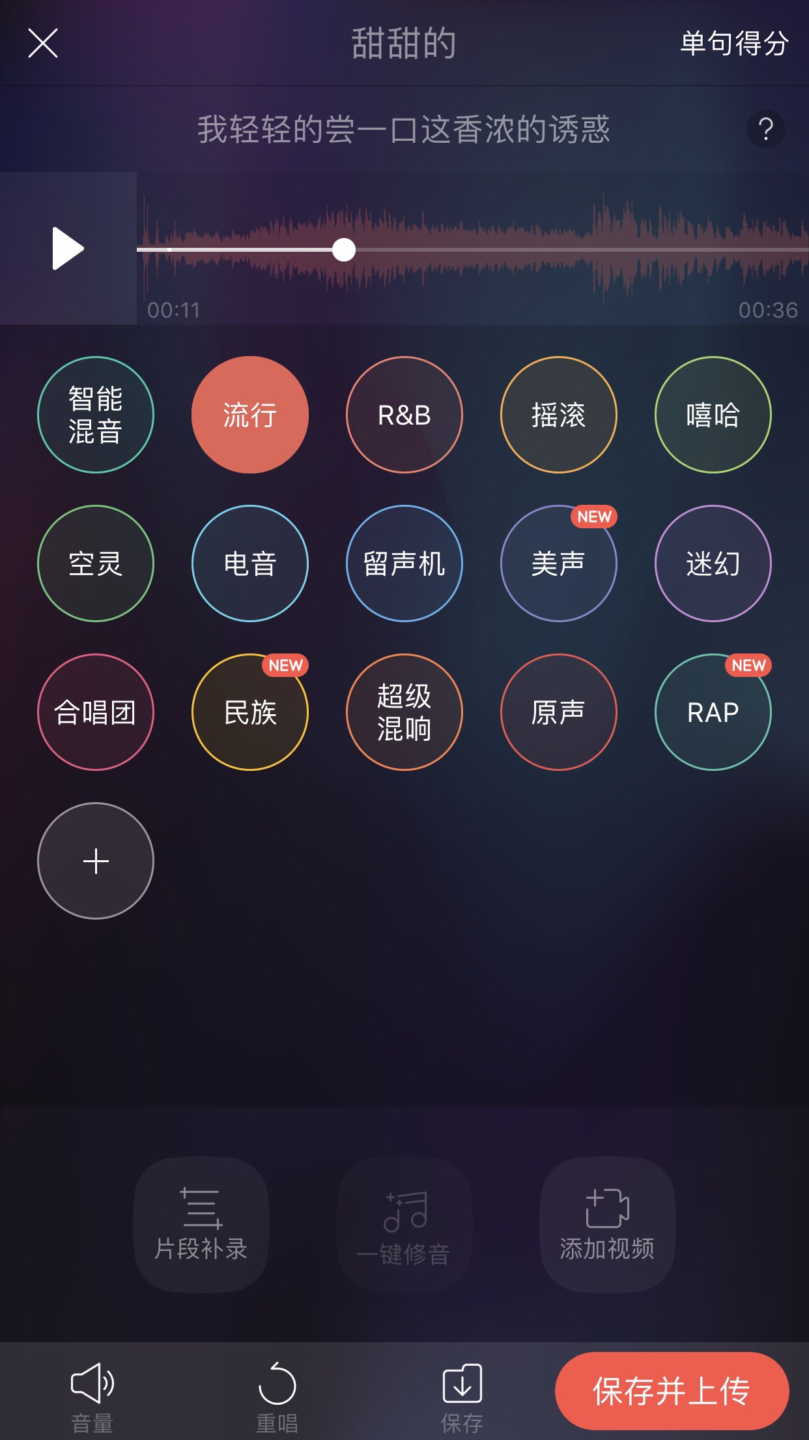
Motivation
Karaoke apps

Slide 4
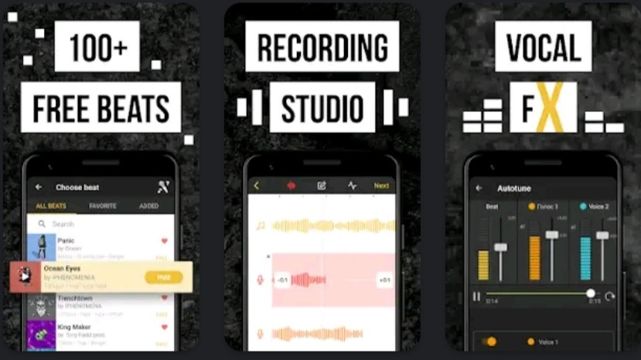
Motivation
Karaoke apps
Amateur music makers

Slide 5
Related Work
Knowledge-based:
Mixing rules and mix analysis

Slide 6
Related Work
Knowledge-based:
Mixing rules and mix analysis
Data-driven:
The main challenge is the data collection of mixing parameters

Slide 7
Related Work
Knowledge-based:
Mixing rules and mix analysis
Data-driven:
Extract mixing parameters from paired raw tracks and human-mixed tracks
Reverse engineering of a mix[1]
Differentiable signal processing chain[2]
Gradient approximation on black-box audio effects[3]

Slide 8
Related Work
Knowledge-based:
Mixing rules and mix analysis
Data-driven:
Extract mixing parameters from paired raw tracks and human-mixed tracks
Reverse engineering of a mix[1]
Differentiable signal processing chain[2]
Gradient approximation on black-box audio effects[3]
End-to-end audio transformation[4]
No further control by users

Slide 9
Related Work
Knowledge-based:
Mixing rules and mix analysis
Data-driven:
Extract mixing parameters from paired raw tracks and human-mixed tracks
Reverse engineering of a mix[1]
Differentiable signal processing chain[2]
Gradient approximation on black-box audio effects[3]
End-to-end audio transformation[4]
No further control by users
Lack of Data

Slide 10
Baseline System
Level balance
−3 dB vocal-to-mix ratio
Compression
14 dB loudness range
EQ
Frequency masking
Reverb
Linear mapping from tempo to reverb time

Slide 11
Proposed Method
Data-driven
Maps the input audio to mixing parameters
Outputs mixing parameters which allows human adjustment
Requires only mixed vocal and backing tracks for training
Raw vocal tracks are not needed

Slide 12
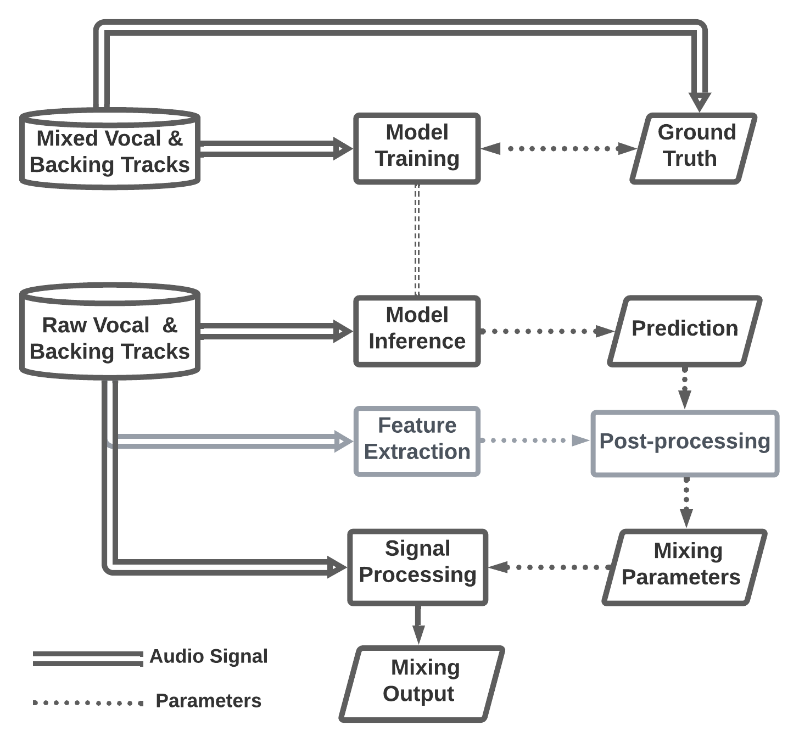

Model Training
Ground truth is the direct or intermediate mixing parameters

Slide 13
Model Training
Ground truth is the direct or intermediate mixing parameters
Optionally, convert intermediate model outputs into direct mixing parameters
Model Inference

Slide 14
Proposed Method -Level Balance and Compression
The model outputs intermediate audio features (relative loudness and loudness range)
Post-processing converts the intermediate features into mixing parameters

Slide 15
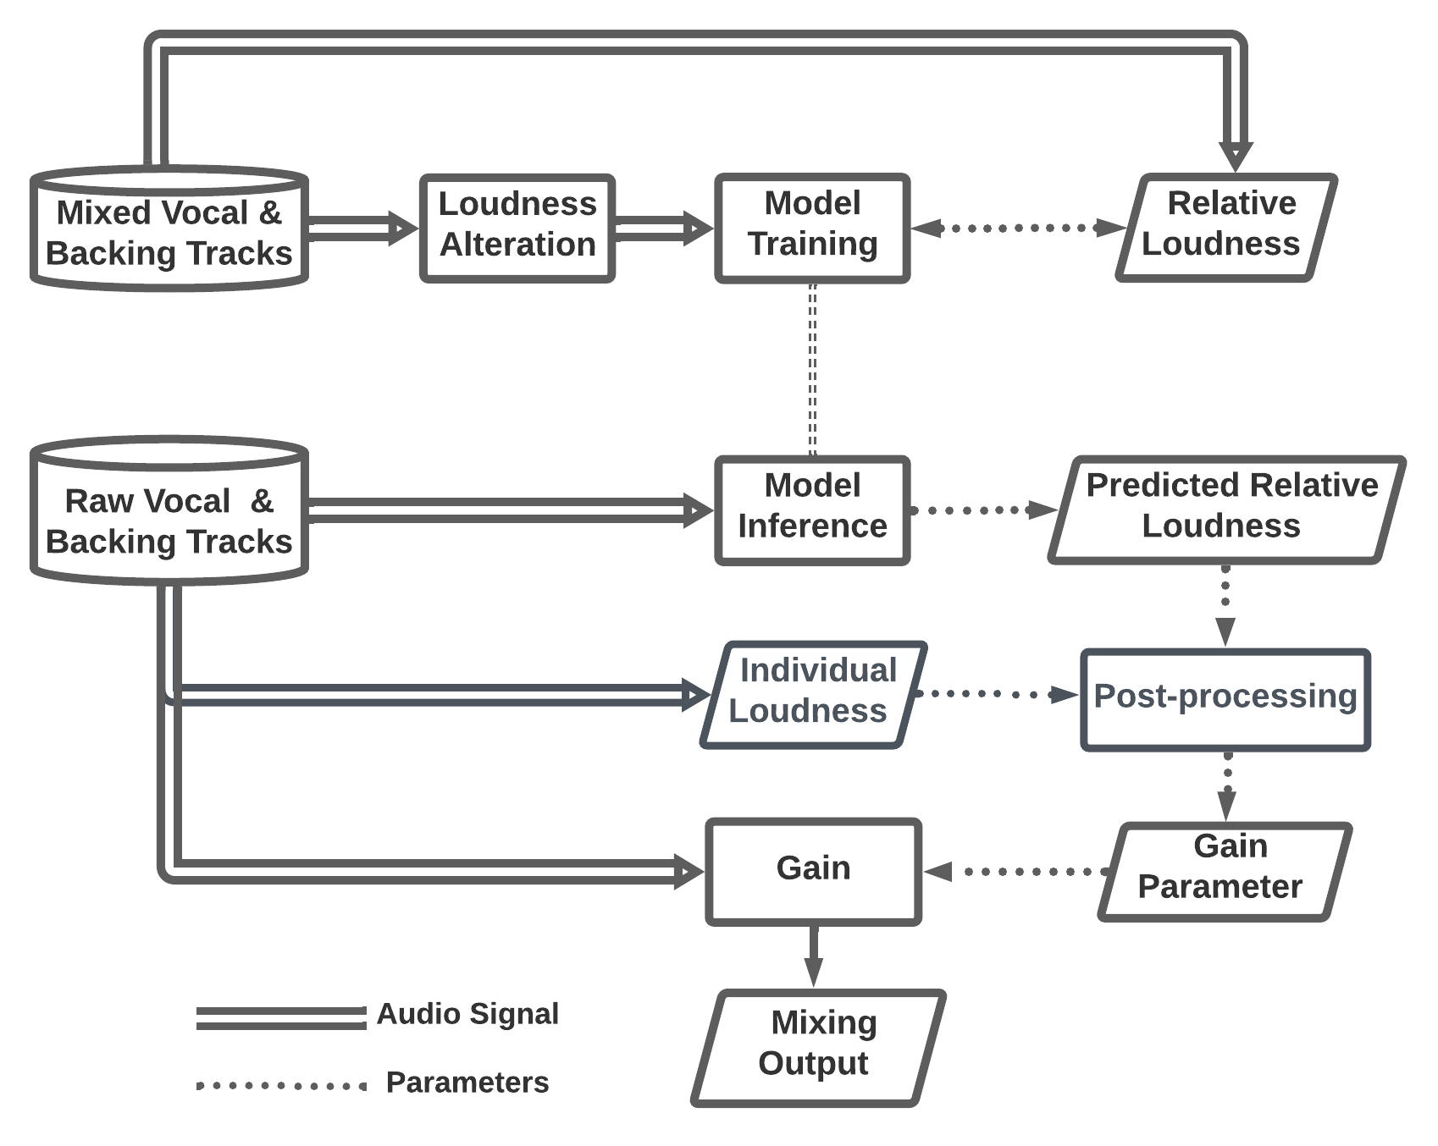
Proposed Method -Level Balance
Model Training
Model Inference

Slide 16
Proposed Method -Level Balance
The model should learn to mix, instead of extracting parameters directly
Model Training
Model Inference

Slide 17
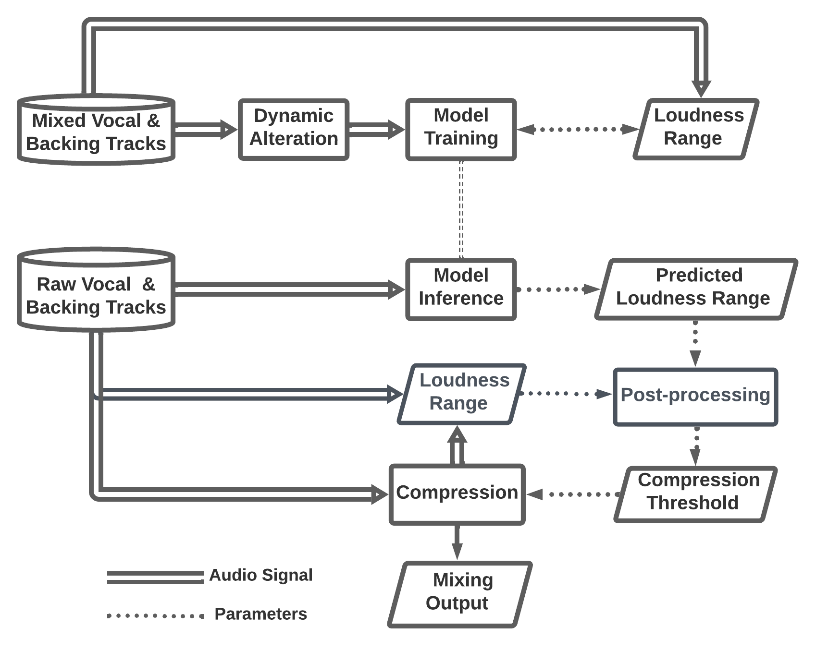
Proposed Method -Compression
Model Training
Model Inference

Slide 18
Proposed Method -Compression
Model Training
Model Inference
An iterative process to find the compression threshold of the targeted loudness range

Slide 19
Proposed Method -Equalization
The “raw” tracks for training are self-generated by applying EQ to the mixed vocal tracks. The corrected parameters are known.

Slide 20
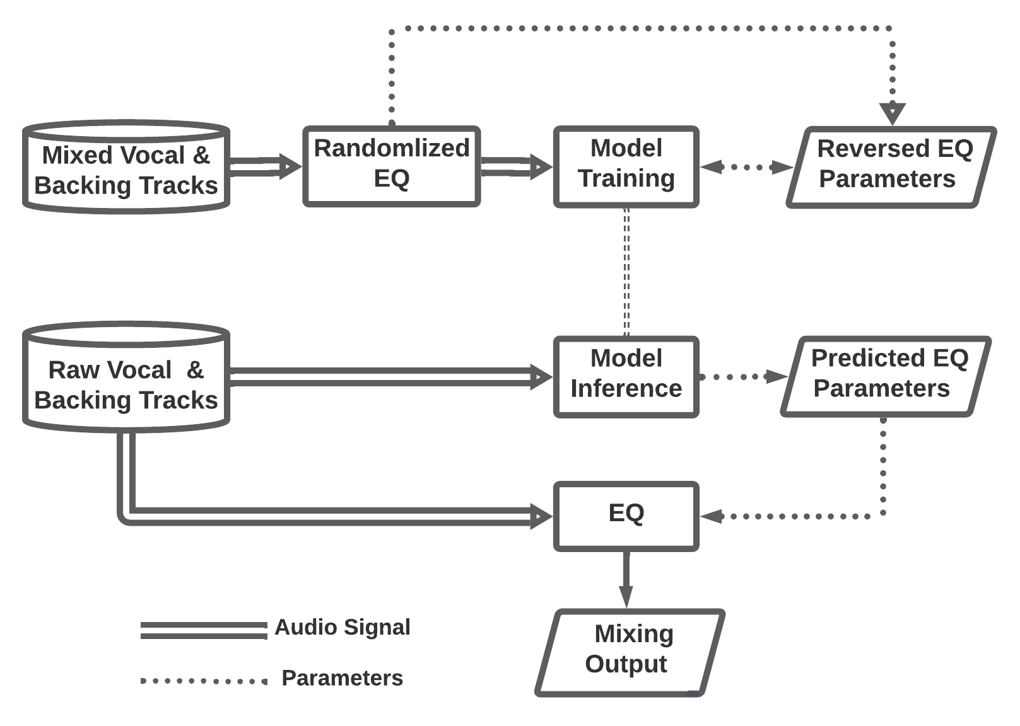
Proposed Method -Equalization
Model Training
Model Inference

Slide 21
Proposed Method -Equalization
Model Training
If the mixed vocal is boosted at some center frequency, we should learn to cut at that frequency.
Model Inference

Slide 22
Proposed Method -Reverberation
Extracts the reverb impulse responses by a commercial plugin
Uses genetic optimization to approximate the reverb parameters for the impulse responses

Slide 23
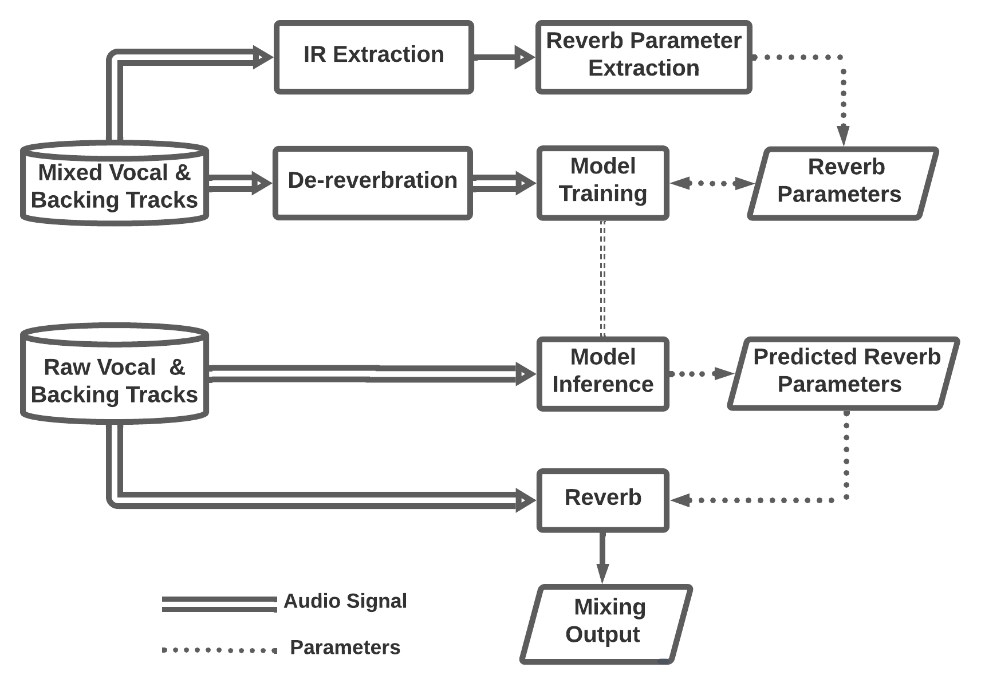
Proposed Method -Reverberation
Model Training
Model Inference

Slide 24
Proposed Method -Reverberation
Model Training
Model Inference

Slide 25
Timeline
March
Baseline system implementation
November
Subjective listening test
December
Warp up
April
Summer
September
October
Reverb parameter extraction
Data collection
Level balance
Reverb parameter extraction
Compression
Experiment preparation
Equalization
Reverberation

Slide 26
References
[1] D. Barchiesi and J. Reiss, “Reverse engineering of a mix,” Journal of Audio Engineering Society, vol. 58, no. 7/8, 2010.
[2] C. J. Steinmetz, J. Pons, S. Pascual, and J. Serra, “Automatic multitrack mixing with a differentiable mixing console of neural audio effects,” in ICASSP, IEEE, 2021.
[3] M. A. Martinez Ramirez, O. Wang, P. Smaragdis, and N. J. Bryan, “Differentiable signal processing with black-box audio effects,” in ICASSP, IEEE, 2021.
[4] M. Martinez Ramirez, D. Stoller, and D. Moffat, “A deep learning approach to intelligent drum mixing with the wave-u-net,” Journal of Audio Engineering Society, vol. 69, no. 3, 2021.
Thank you!

